Slide 1
Exercising Faith
Through Faith Based on Relationship

Slide 2
Gal. 5:6
As far as our relationship to Christ Jesus is concerned, it doesn't matter whether we are circumcised or not. But what matters is a faith that expresses itself through love. (Gal. 5:6; God's Word Translation)

Slide 3
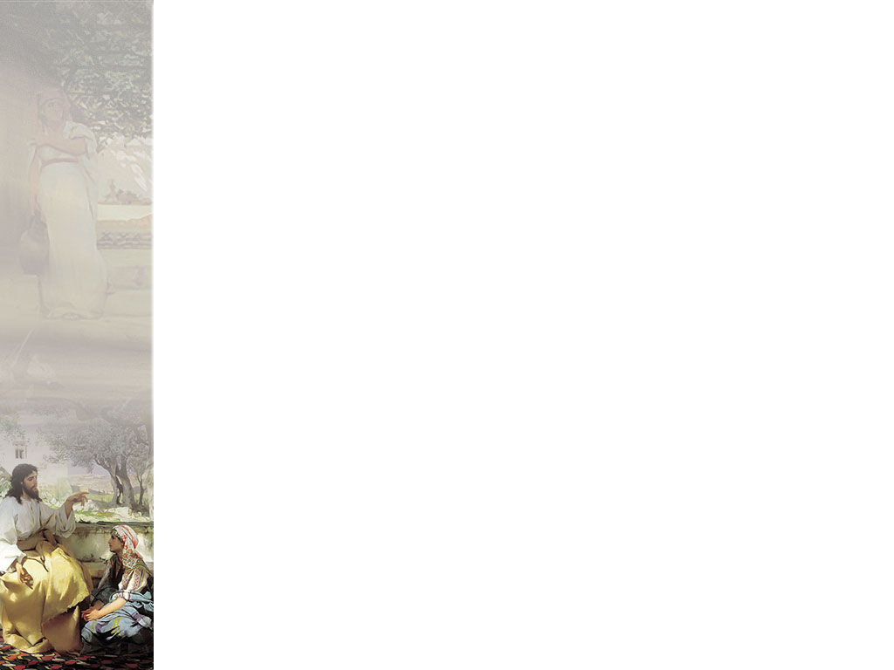
The Love Relationship
True faith in God cannot be separated from a love for Him
True love cannot be separated from a relationship.
Faith in God is expressed by LOVE for Him and others

Slide 4
1 Cor. 13
4Love is patient and kind. Love is not jealous or boastful or proud 5or rude. Love does not demand its own way. Love is not irritable, and it keeps no record of when it has been wronged. 6It is never glad about injustice but rejoices whenever the truth wins out. 7Love never gives up, never loses faith, is always hopeful, and endures through every circumstance. (New Living Translation)
Or as The New Century Version renders verse 7:
Love patiently accepts all things. It always trusts, always hopes, and always remains strong. (New Century Version)

Slide 5
The Love Relationship
True love for God will never question His character
True love will never lose faith in God (which would be to question His character) but continues to trust Him regardless of circumstances.
One cannot establish a genuine relationship apart from “trust”.
Therefore, in order for one to exercise genuine faith in God, they must have an established love relationship with Him. This is culminated in the word “trust”:

Slide 6
Proverbs 3
5 Trust in the LORD with all thine heart; and lean not unto thine own understanding. 6 In all thy ways acknowledge him, and he shall direct thy paths.
7 Be not wise in thine own eyes: fear the LORD, and depart from evil. 8 It shall be health to thy navel, and marrow to thy bones. 9 Honour the LORD with thy substance, and with the firstfruits of all thine increase: 10 So shall thy barns be filled with plenty, and thy presses shall burst out with new wine.

Slide 7
What Does it Mean to “Trust”
Batach (Hebrew word for “trust”) - to have confidence, be confident; to be bold; to be secure; to feel safe, be careless (free of worry)
Random House Dictionary - reliance on the integrity, strength, ability, surety, etc., of a person or thing; confidence.
World English Dictionary - reliance on and confidence in the truth, worth, reliability, etc, of a person or thing; faith-Related:
Pastor Troy – Trusting in the Lord means having an intimate knowledge of His loving character as a result of an intimate relationship. Faith-Trust is based on RELATIONSHIP.

Slide 8
Is “Trust” Different from “Faith”?
Many attempt to make a distinction between “faith” and “trust” as though they are two different concepts. I believe that this is a mistake.
“Faith” is often seen as something intellectual from one extreme or something mystical on another extreme.
“Trust” connotes something more along the lines of relationship than the unfortunate way that Christians have used the word “faith”.
Concerning faith in God: Greeks see faith as intellectual; they express it through creeds and doctrines. Hebrews see faith as relational and personal; they express it in terms of relationship rather than as a mental construct.

Slide 9
Is “Trust” Different from “Faith”?
While much of our present day Christianity has been influenced by Greek and Western culture, the original Christians thought more in the light of Hebrew culture.
“Concerning faith in God: Greeks see faith as intellectual; they express it through creeds and doctrines. Hebrews see faith as relational and personal; they express it in terms of relationship rather than as a mental construct.” (Scarone, The God we Worship, pp. 13-14)
I personally believe that the loss of this understanding of relationship factor in some of our faith teaching have caused many people to fail to grasp and practice with full commitment the message of faith.

Slide 10
Trust demonstrated by “acknowledging”
To “acknowledge” here means “to know someone carnally” or “to reveal one’s self”.
Trusting God is not a matter of relying upon one's own reasoning faculties.
We cannot claim to be “trusting God” when we fail to acknowledge Him in our own plans.:
This is why so many of God’s people fall short of true faith. They mentally acknowledge God, they affirm truth about Him, but they continue to lean to their own understanding in solving problems and in life in general.

Slide 11
How Some Faith Principles are Better Understood in the Light of Relationship
Faith coming by Hearing the Word of God (Rom. 10:17) – When we trust God we will have no doubt that He means what He says (2 Cor. 1:18-20), would never lie about it, is able to do it, and willing to do it for us.
Walking by faith and not by sight (2 Cor. 5:7; Heb. 11:1) – When we trust God then we will accept what He says in spite of no evidence or evidence to the contrary. Circumstances and feelings will not take precedence over what God has promised even if we have no tangible evidence of His promise.
Positive confession – faith confession (Rom. 10:8-10; Heb. 4:14; 10:23) – If we trust Him then we will say what He says rather than speak contrary to what He says.

Slide 12
Psalm 91
1 He that dwelleth in the secret place of the most High shall abide under the shadow of the Almighty. 2 I will say of the LORD, He is my refuge and my fortress: my God; in him will I trust.
3 Surely he shall deliver thee from the snare of the fowler, and from the noisome pestilence. 4 He shall cover thee with his feathers, and under his wings shalt thou trust: his truth shall be thy shield and buckler.
5 Thou shalt not be afraid for the terror by night; nor for the arrow that flieth by day; 6 Nor for the pestilence that walketh in darkness; nor for the destruction that wasteth at noonday.

Slide 13
Look at God’s Character:
God is Completely
TRUSTWORTHY

Slide 14
What does it mean to be “trustworthy”
The Bible often uses the word “faithfulness” which basically means “trustworthy”.
Pistis - fidelity, faithfulness; the character of one who can be relied on
The first key to exercising faith is to know the truth about God’s character – that He is completely worthy of our trust.

Slide 15
God is Completely “Trustworthy”
1Co 1:9 God is faithful (reliable, trustworthy, and therefore ever true to His promise, and He can be depended on); by Him you were called into companionship and participation with His Son, Jesus Christ our Lord. (Amplified)

Slide 16
Trust Based on Relationship
The word “companionship” (KJV uses the word “fellowship”) is from the Greek word koinonia which is in relation to “community” or “intimacy”.
One cannot count God as worthy of their trust apart from a true relationship with Him.

Slide 17
God is Completely “Trustworthy”
Heb 11:11 Because of faith also Sarah herself received physical power to conceive a child, even when she was long past the age for it, because she considered [God] Who had given her the promise to be reliable and trustworthy and true to His word.(5) (Amplified)

Slide 18
Why this Emphasis on God being Worthy of Trust?
God has been lied on time and time again concerning His character.
These lies have not only come from Satan, but Satan has actually been able to propagate lies concerning God’s character through the church.

Slide 19
God’s Character Slandered
1 Now the serpent was more subtil than any beast of the field which the LORD God had made. And he said unto the woman, Yea, hath God said, Ye shall not eat of every tree of the garden? 2 And the woman said unto the serpent, We may eat of the fruit of the trees of the garden: 3 But of the fruit of the tree which is in the midst of the garden, God hath said, Ye shall not eat of it, neither shall ye touch it, lest ye die.
4 And the serpent said unto the woman, Ye shall not surely die: 5 For God doth know that in the day ye eat thereof, then your eyes shall be opened, and ye shall be as gods, knowing good and evil.
6 And when the woman saw that the tree was good for food, and that it was pleasant to the eyes, and a tree to be desired to make one wise, she took of the fruit thereof, and did eat, and gave also unto her husband with her; and he did eat

Slide 20
The first sin was a “Breach of Trust”
Satan painted a picture of God as egotistical, selfish, tyrannical, and totally untrustworthy.
He does the same thing today, often using religious terminology:
  God’s ways are mysterious. You never know what He will do.
  God is sovereign so what is happening in your life is His will for you.
  God did not answer your prayer because it was not His will, in spite of what the Bible promised you.
  God is angry with you and will destroy you you wretched sinner.
  God does not love you

Slide 21
Lack of trust resulted in “death” which is separation
Failure to believe what God says about Himself rather than what His enemy said brought death upon Adam and Eve.
This “death” did not start as “physical”. It was seperation from the life of God.
Separation from God means a break in the relationship with Him.
Unlike Adam and Eve, we must be more like Sarah, who judged God as “trustworthy”.

Slide 22
God is Completely “Trustworthy”
Although not all believe God's words, this does not affect His faithfulness towards those He had chosen. It is unthinkable that He would ever be unfaithful; He is true and trustworthy in every way, even though no man can make such a claim about himself. (Rom. 3:3-4; The Truth New Testament by Apostle Colin Urquhart)

