Slide 1
Exercising Faith (Pt. 2)
Through Faith Based on Relationship

Slide 2
1 John 4:8-10
He that loveth not knoweth not God; for God is love. In this was manifested the love of God toward us, because that God sent his only begotten Son into the world, that we might live through him. Herein is love, not that we loved God, but that he loved us, and sent his Son to be the propitiation for our sins. (1 John 4:8-10)

Slide 3
Rom. 8:31-32
What shall we then say to these things? If God be for us, who can be against us? He that spared not his own Son, but delivered him up for us all, how shall he not with him also freely give us all things? (Rom. 8:31-32)

Slide 4
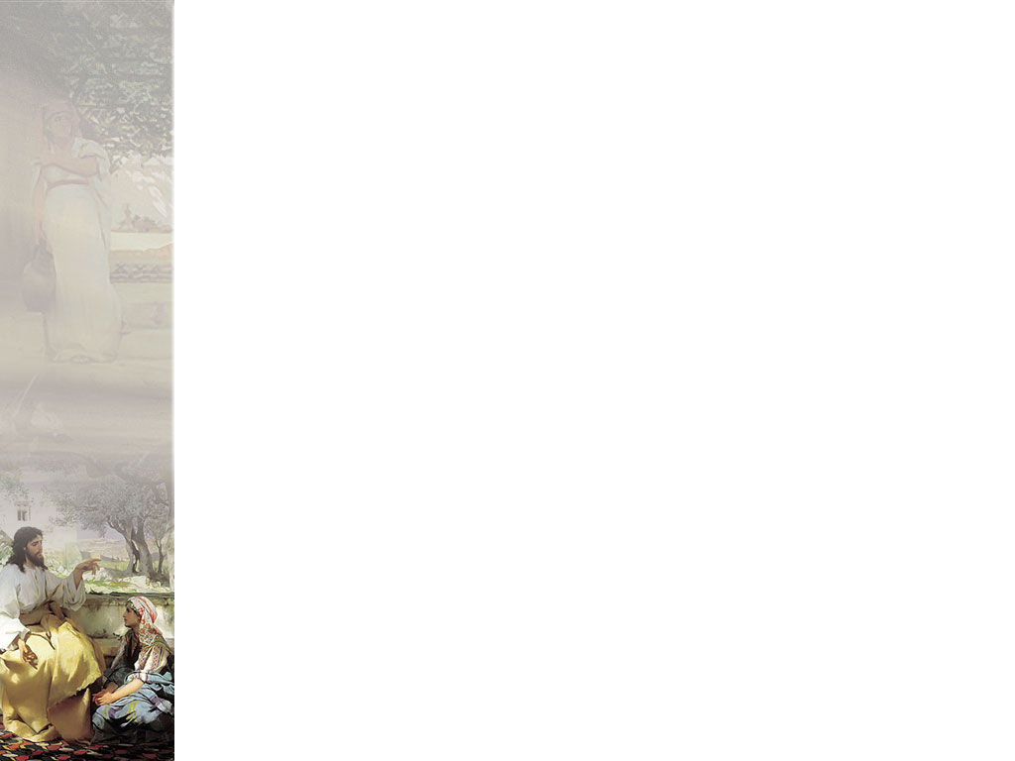
The Love Relationship
We cannot truly trust God until we know beyond a shadow of a doubt that He loves us
He demonstrates love for us by giving us His Son as the supreme example of what it means to have self-sacrificing, others-centered love.

Slide 5
1 Pet. 5:6-8
Humble yourselves therefore under the mighty hand of God, that he may exalt you in due time: Casting all your care upon him; for he careth for you. Be sober, be vigilant; because your adversary the devil, as a roaring lion, walketh about, seeking whom he may devour: (1 Pet. 5:6-8)
All of you are to humble yourselves under God’s mighty hand of authority, so that in His time He will lift you up to be with Him. Because He is so concerned about you, He wants you to lay all your problems, troubles and anxieties on Him (1 Pet. 5:6-7; The Truth New Testament by Colin Urquhart)

Slide 6
The Love Relationship
God loves us and cares about us. Satan hates our guts and is the cause of our problems.
We often hear teaching on God’s omnipotence and authority that sounds like anything other than what we understand about love.
God’s sovereignty is a sovereignty of love. His love gives men freedom to obey or disobey Him.
The devil would prefer to enslave us. God wants us to love Him freely and submit to Him. To TRUST HIM.
God's sovereignty is a sovereignty of love; His love offers itself to man's free response, a free response itself awakened by the operations of grace. (H. D. McDonald, The God Who Responds)

Slide 7
The Love Relationship
God's sovereignty is the sovereignty of fatherhood, which is another way of saying that it is the sovereignty of love. Here is the vital distinction between mediaeval or feudal Christianity and the Christianity of modern thought. (William James McKittrick, D.D., LL.D, The Biblical World, P. 222, 1917)

Slide 8
Isa. 55
For my thoughts are not your thoughts, neither are your ways my ways, saith the LORD. For as the heavens are higher than the earth, so are my ways higher than your ways, and my thoughts than your thoughts. (Isa. 55:8-9)

Slide 9
The Love Relationship
This passage is so often quoted out of context to support erroneous ideas about God that contradict the nature of His love.
When passages are misquoted in this manner they begin to diminish what it means to trust God.
When read in context we see that passages of this nature actually establish the trust relationship with God.

Slide 10
Isa. 55
Seek ye the LORD while he may be found, call ye upon him while he is near: Let the wicked forsake his way, and the unrighteous man his thoughts: and let him return unto the LORD, and he will have mercy upon him; and to our God, for he will abundantly pardon. For my thoughts are not your thoughts, neither are your ways my ways, saith the LORD. For as the heavens are higher than the earth, so are my ways higher than your ways, and my thoughts than your thoughts. (Isa. 55:6-9)

Slide 11
Knowing that God loves Us
Will keep us from being afraid of Him. It trust God for His protection over us.

Slide 12
Psalm 91
1 He that dwelleth in the secret place of the most High shall abide under the shadow of the Almighty. 2 I will say of the LORD, He is my refuge and my fortress: my God; in him will I trust.
3 Surely he shall deliver thee from the snare of the fowler, and from the noisome pestilence. 4 He shall cover thee with his feathers, and under his wings shalt thou trust: his truth shall be thy shield and buckler.
5 Thou shalt not be afraid for the terror by night; nor for the arrow that flieth by day; 6 Nor for the pestilence that walketh in darkness; nor for the destruction that wasteth at noonday.

Slide 13
Look at God’s Character:
God is Completely
TRUSTWORTHY

Slide 14
What does it mean to be “trustworthy”
The Bible often uses the word “faithfulness” which basically means “trustworthy”.
Pistis - fidelity, faithfulness; the character of one who can be relied on
The first key to exercising faith is to know the truth about God’s character – that He is completely worthy of our trust.

Slide 15
God is Completely “Trustworthy”
1Co 1:9 God is faithful (reliable, trustworthy, and therefore ever true to His promise, and He can be depended on); by Him you were called into companionship and participation with His Son, Jesus Christ our Lord. (Amplified)

Slide 16
Trust Based on Relationship
The word “companionship” (KJV uses the word “fellowship”) is from the Greek word koinonia which is in relation to “community” or “intimacy”.
One cannot count God as worthy of their trust apart from a true relationship with Him.

Slide 17
God is Completely “Trustworthy”
Heb 11:11 Because of faith also Sarah herself received physical power to conceive a child, even when she was long past the age for it, because she considered [God] Who had given her the promise to be reliable and trustworthy and true to His word.(5) (Amplified)

Slide 18
Why this Emphasis on God being Worthy of Trust?
God has been lied on time and time again concerning His character.
These lies have not only come from Satan, but Satan has actually been able to propagate lies concerning God’s character through the church.

Slide 19
God’s Character Slandered
1 Now the serpent was more subtil than any beast of the field which the LORD God had made. And he said unto the woman, Yea, hath God said, Ye shall not eat of every tree of the garden? 2 And the woman said unto the serpent, We may eat of the fruit of the trees of the garden: 3 But of the fruit of the tree which is in the midst of the garden, God hath said, Ye shall not eat of it, neither shall ye touch it, lest ye die.
4 And the serpent said unto the woman, Ye shall not surely die: 5 For God doth know that in the day ye eat thereof, then your eyes shall be opened, and ye shall be as gods, knowing good and evil.
6 And when the woman saw that the tree was good for food, and that it was pleasant to the eyes, and a tree to be desired to make one wise, she took of the fruit thereof, and did eat, and gave also unto her husband with her; and he did eat

Slide 20
The first sin was a “Breach of Trust”
Satan painted a picture of God as egotistical, selfish, tyrannical, and totally untrustworthy.
He does the same thing today, often using religious terminology:
  God’s ways are mysterious. You never know what He will do.
  God is sovereign so what is happening in your life is His will for you.
  God did not answer your prayer because it was not His will, in spite of what the Bible promised you.
  God is angry with you and will destroy you you wretched sinner.
  God does not love you

Slide 21
Lack of trust resulted in “death” which is separation
Failure to believe what God says about Himself rather than what His enemy said brought death upon Adam and Eve.
This “death” did not start as “physical”. It was seperation from the life of God.
Separation from God means a break in the relationship with Him.
Unlike Adam and Eve, we must be more like Sarah, who judged God as “trustworthy”.

Slide 22
God is Completely “Trustworthy”
Although not all believe God's words, this does not affect His faithfulness towards those He had chosen. It is unthinkable that He would ever be unfaithful; He is true and trustworthy in every way, even though no man can make such a claim about himself. (Rom. 3:3-4; The Truth New Testament by Apostle Colin Urquhart)

