Slide 1
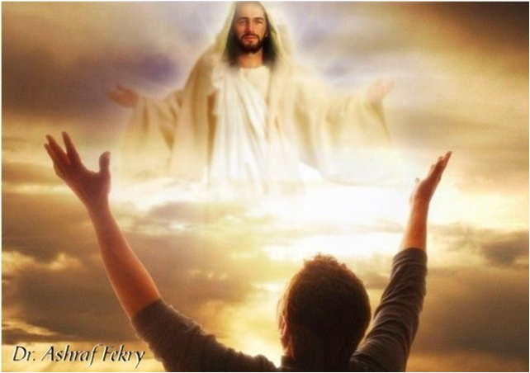
Exercising Faith
Through Faith Based on Relationship

Slide 2

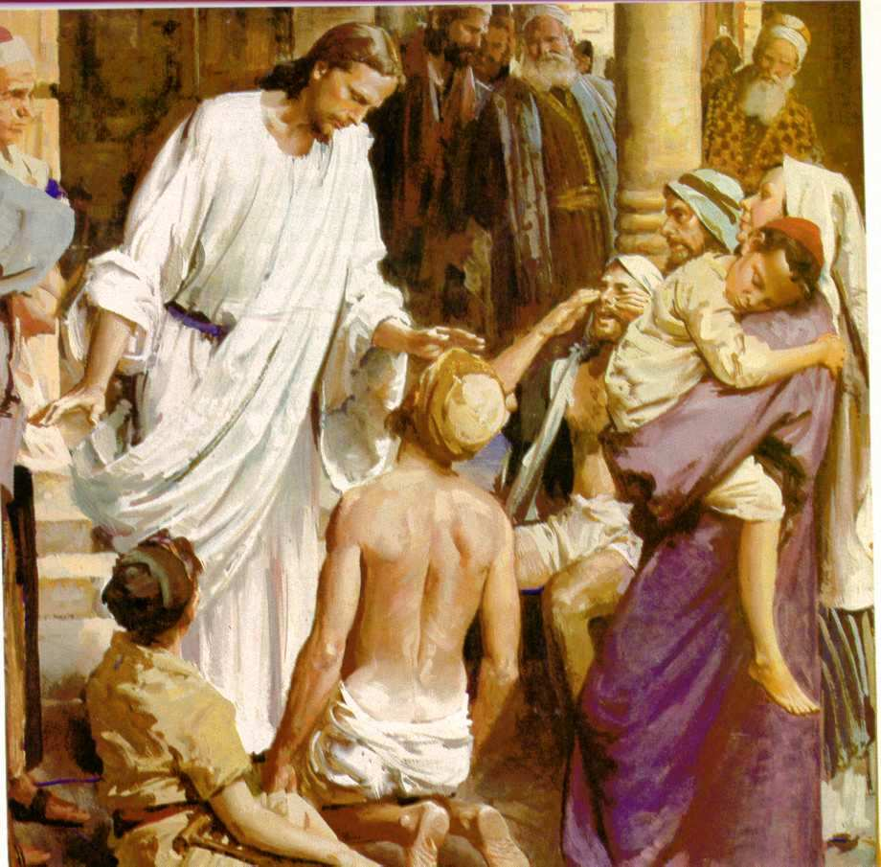
God Cannot be pleased apart from genuine faith/Trust
But without faith it is impossible to please him: for he that cometh to God must believe that he is, and that he is a rewarder of them that diligently seek him (Heb. 11:6)

Slide 3
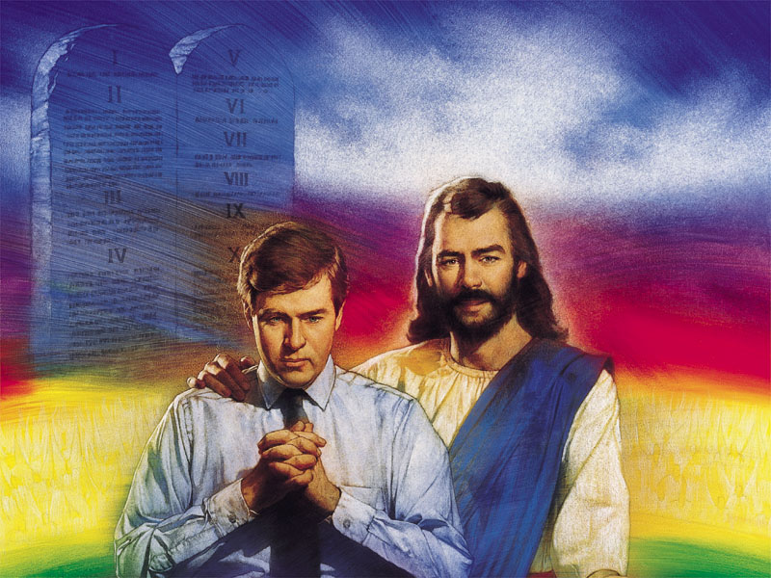
[A]nd without trusting it is impossible to please God: for it is necessary for one who comes to God to believe because then He becomes a rewarder to those who seek Him out. (Heb. 11:6; The Power New Testament by William J. Morford).
To receive consistent answers to prayer rather than hit and misses as too many Christians experience, we must develop a trusting relationship with God.

Slide 4

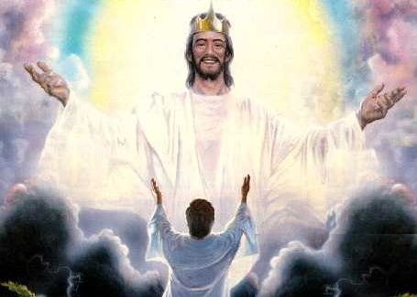
By now you can see that it is impossible to please God without faith. In our relationship with Him, we have to believe that He not only exists, but actually wants to answer us when we pray. He longs to give us what we need when we seek Him with sincere and earnest faith. (Heb. 11:6; The Truth New Testament)

Slide 5
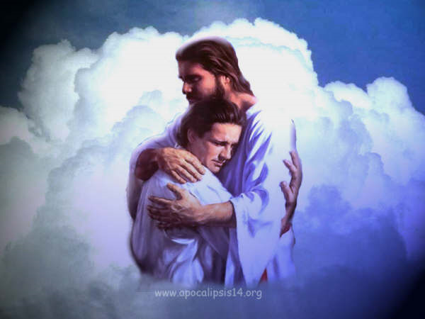
Father Genuinely Cares About Us
But it's impossible to please God without having faith. Those who come to God must not only believe that He exists, but that He cares and rewards those who search for Him. (Heb. 11:6; The Clear Word, a paraphrase by Jack Blanco).
See Also 1 Pet. 5:7

Slide 6
“ Now faith is the substance of things hoped for, the evidence of things not seen.” (Hebrews 11:1, KJV).
In order for God’s people to know how to exercise faith, they must know what it is.

Slide 7
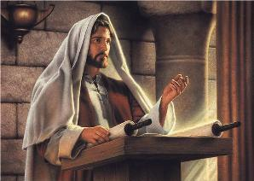
The Greek word for “faith” in this passage can also be translated “trust”.
William J. Morford, author of “The Power New Testament” writes, “The word we normally translate ‘faith’ meant ‘trust’ to the NT authors.

Slide 8
Paraphrases/Translations of Heb. 11:1
The fundamental fact of existence is that this trust in God, this faith, is the firm foundation under everything that makes life worth living. It's our handle on what we can't see. (The Message)
True faith is being sure of the hope we have and being certain that we shall see what has been promised, even though we do not see these things at present. (The Truth New Testament)

Slide 9
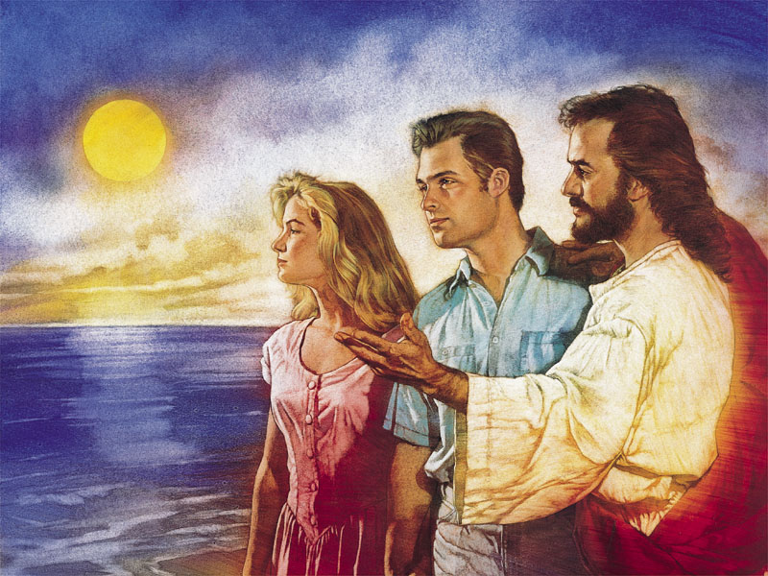
True faith is trust in God based on our relationship with Him. It is having such a trust in Him that we count what He promised us as already done even though we do not have any visible tangible evidence concerning it at present.

Slide 10
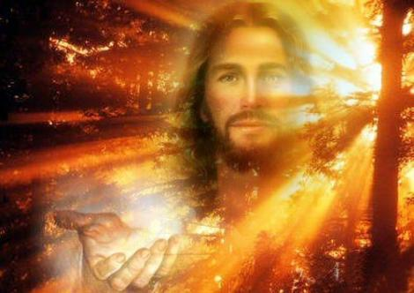
True faith counts God to be completely and implicitly TRUSTWORTHY IN SPITE OF ALL EVIDENCE THAT APPEARS TO POINT TO THE CONTRARY

Slide 11

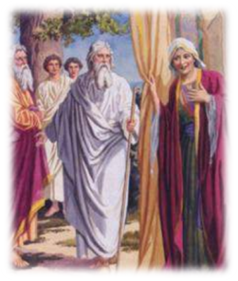
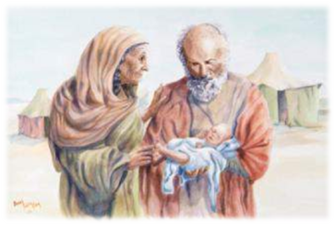
ABRAHAM & SARAH
Through faith also Sarah herself received strength to conceive seed, and was delivered of a child when she was past age, because she judged him faithful that promised. (Heb. 11:11)
The word “faithful” in this passage means “one…. worthy of trust.”6 The Amplified Bible reads, "she considered [God] Who had given her the promise to be reliable and trustworthy and true to His word."

Slide 12
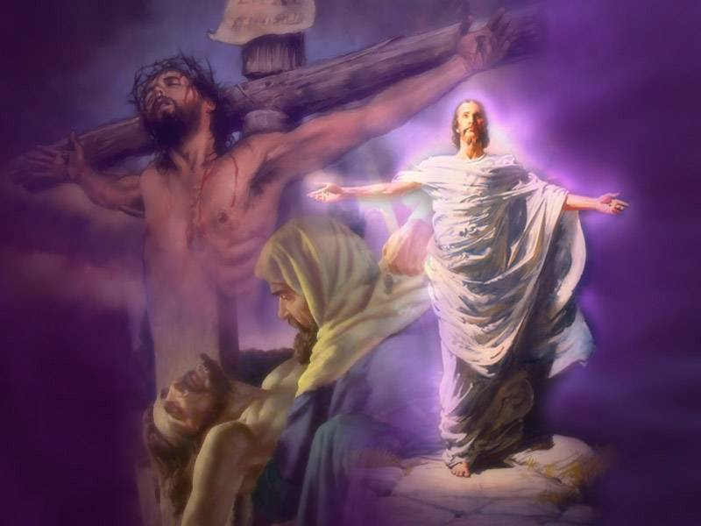
God has given us every incentive by which we can consider Him trustworthy. He paid the ultimate sacrifice by dying for us. How could someone of this magnitude of love not be counted trustworthy in spite of the fact that we may not always see visible and tangible evidences of it.

Slide 13

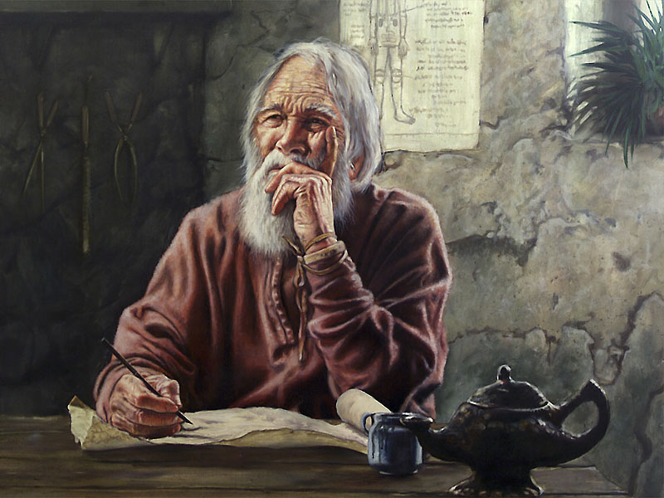
The Life of Trust according to Paul
For we walk by faith,
not by sight (2 Cor. 5:7).
For we walk by faith [we regulate our lives and conduct ourselves by our conviction or belief respecting man's relationship to God and divine things, with trust and holy fervor; thus we walk] not by sight or appearance. (Amplified Bible)

Slide 14
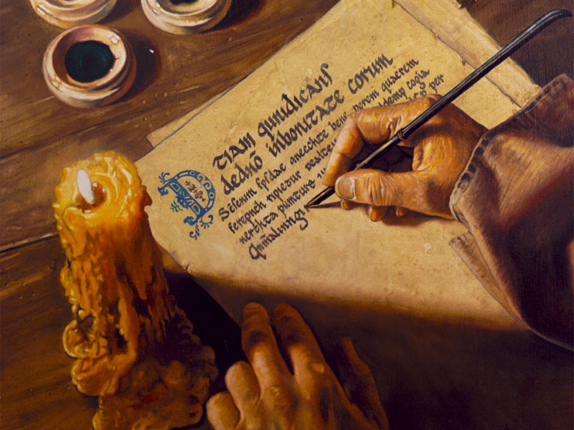
2 Cor. 4
16 For which cause we faint not; but though our outward man perish, yet the inward man is renewed day by day.
17 For our light affliction, which is but for a moment, worketh for us a far more exceeding and eternal weight of glory;
18 While we look not at the things which are seen, but at the things which are not seen: for the things which are seen are temporal; but the things which are not seen are eternal.

Slide 15

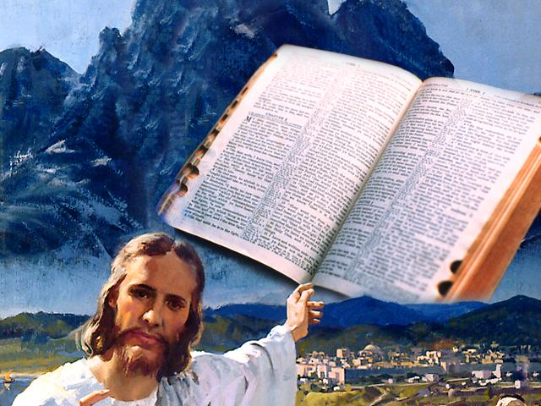
16 That is why we never give up. Though our bodies are dying, our spirits are[e] being renewed every day.
17 For our present troubles are small and won’t last very long. Yet they produce for us a glory that vastly outweighs them and will last forever!
18 So we don’t look at the troubles we can see now; rather, we fix our gaze on things that cannot be seen. For the things we see now will soon be gone, but the things we cannot see will last forever. (New Living Translation)

Slide 16

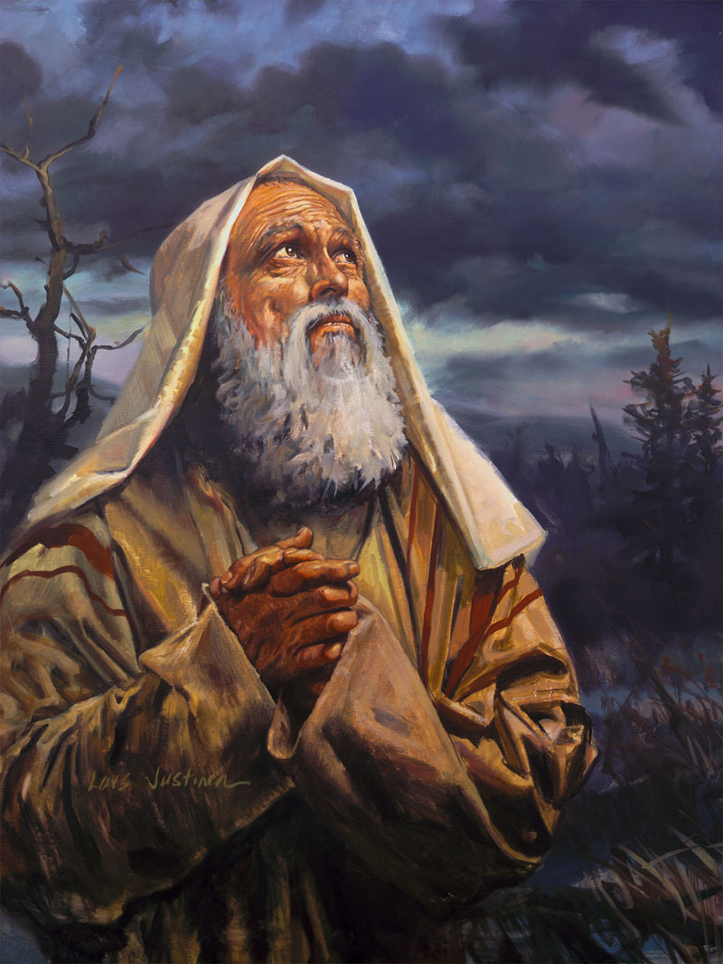
Abraham’s Faith
"(As it is written, I have made thee a father of many nations,) before him whom he believed, even God even God, who quickeneth the dead, and calleth those things that be not as though they were." (Rom. 4:17b)

Slide 17
Abraham’s Faith
"Who against hope believed in hope, that he might become the father of many nations, according to that which was spoken, so shall they seed be." (Rom. 4:18).

Slide 18
Abraham’s Faith
"And being not weak in faith, he CONSIDERED NOT his own body now dead, when he was about a hundred years old, neither yet the deadness of Sarah's womb. He staggered not at the promise of God through unbelief; but was strong in faith giving glory to God." (Rom. 4:19-20)

Slide 19
The Life of Trust according to Paul
For we walk by faith,
not by sight (2 Cor. 5:7).
For we walk by faith [we regulate our lives and conduct ourselves by our conviction or belief respecting man's relationship to God and divine things, with trust and holy fervor; thus we walk] not by sight or appearance. (Amplified Bible)

Slide 20
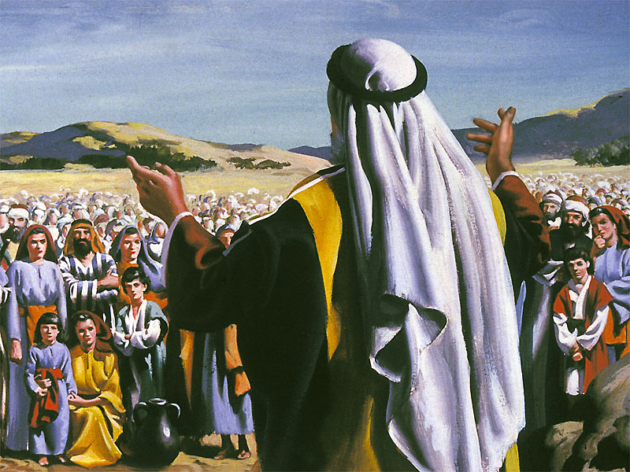
And they brought up an evil report of the land which they had searched unto the children of Israel, saying, The land, through which we have gone to search it, is a land that eateth up the inhabitants thereof; and all the people that we saw in it are men of a great stature. (Num. 13:32)

Slide 21
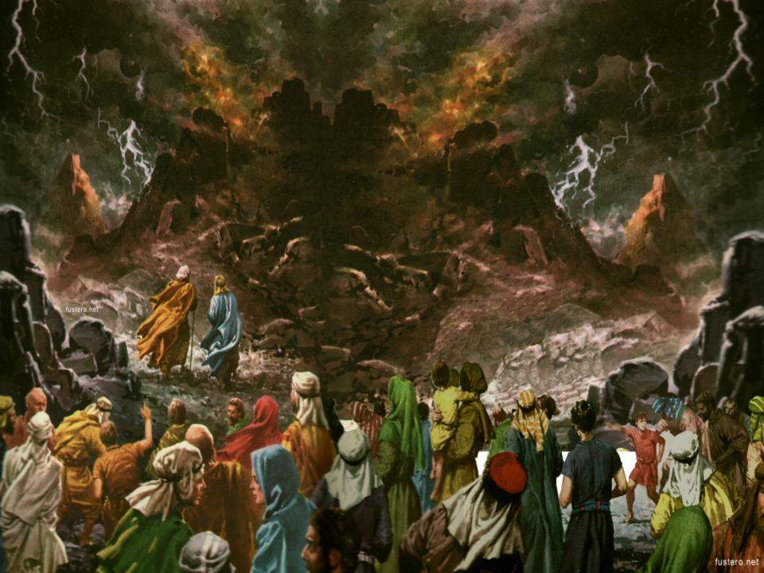
And there we saw the giants, the sons of Anak, which come of the giants: and we were in our own sight as grasshoppers, and so we were in their sight. (Num. 13:33)

Slide 22
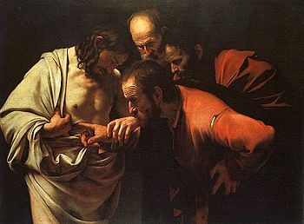
Our Lord’s Admonishment to Thomas
John 20
26 And after eight days again his disciples were within, and Thomas with them: then came Jesus, the doors being shut, and stood in the midst, and said, Peace be unto you.
27 Then saith he to Thomas, Reach hither thy finger, and behold my hands; and reach hither thy hand, and thrust it into my side: and be not faithless, but believing.

Slide 23
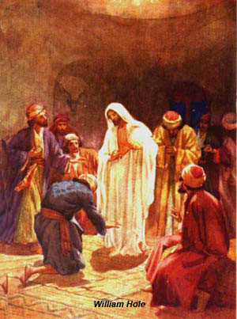
Our Lord’s Admonishment to Thomas
John 20
28 And Thomas answered and said unto him, My Lord and my God.
29 Jesus saith unto him, Thomas, because thou hast seen me, thou hast believed: blessed are they that have not seen, and yet have believed.

Slide 24
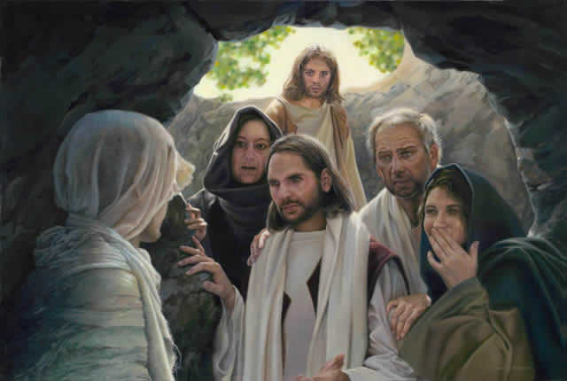
Our Lord’s Admonishment to Mary Magdalene
John 11
39 Jesus said, Take ye away the stone. Martha, the sister of him that was dead, saith unto him, Lord, by this time he stinketh: for he hath been dead four days.
40 Jesus saith unto her, Said I not unto thee, that, if thou wouldest believe, thou shouldest see the glory of God?

Slide 25
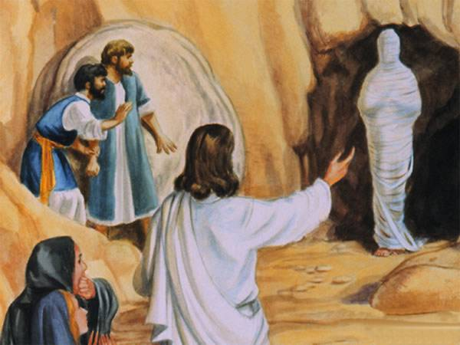
Our Lord’s Admonishment to Mary Magdalene
John 11
40 Jesus said to her, Did I not tell you and [a]promise you that if you would believe and rely on Me, you would see the glory of God? (The Amplified Bible)

Slide 26
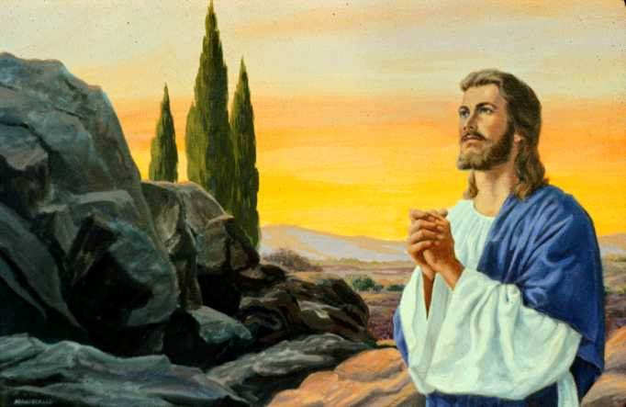
Jesus Demonstrates How True Faith is
Exercised in a relationship with God
Jesus saith unto her, Thy brother shall rise again.... Then they took away the stone from the place where the dead was laid. And Jesus lifted up his eyes, and said, Father, I thank thee that thou hast heard me. And I knew that thou hearest me always: but because of the people which stand by I said it, that they may believe that thou hast sent me (John 11:23, 41, 42)

Slide 27
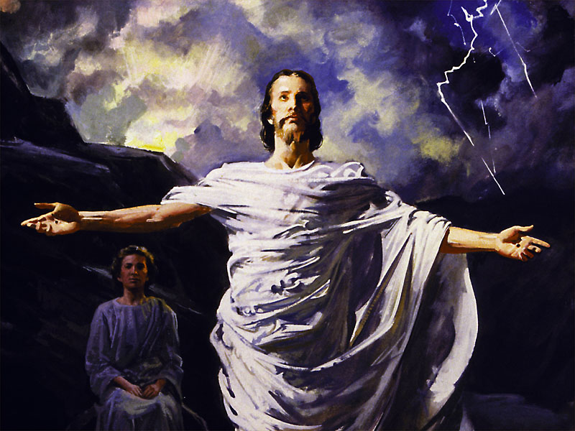
The Lord boldly tells Martha, “Thy brother shall rise again.” This is a statement of faith—of confident expectation. Then in His prayer to the Father, our Lord offers thanksgiving.
He did this because he believed that God heard Him and always hears Him. Faith believes that it is heard by God before seeing any tangible evidence of it. Later, John would write, “And if we know that he hear us, whatsoever we ask, we know that we have the petitions that we desired of him” (1 John 5:14).

Slide 28
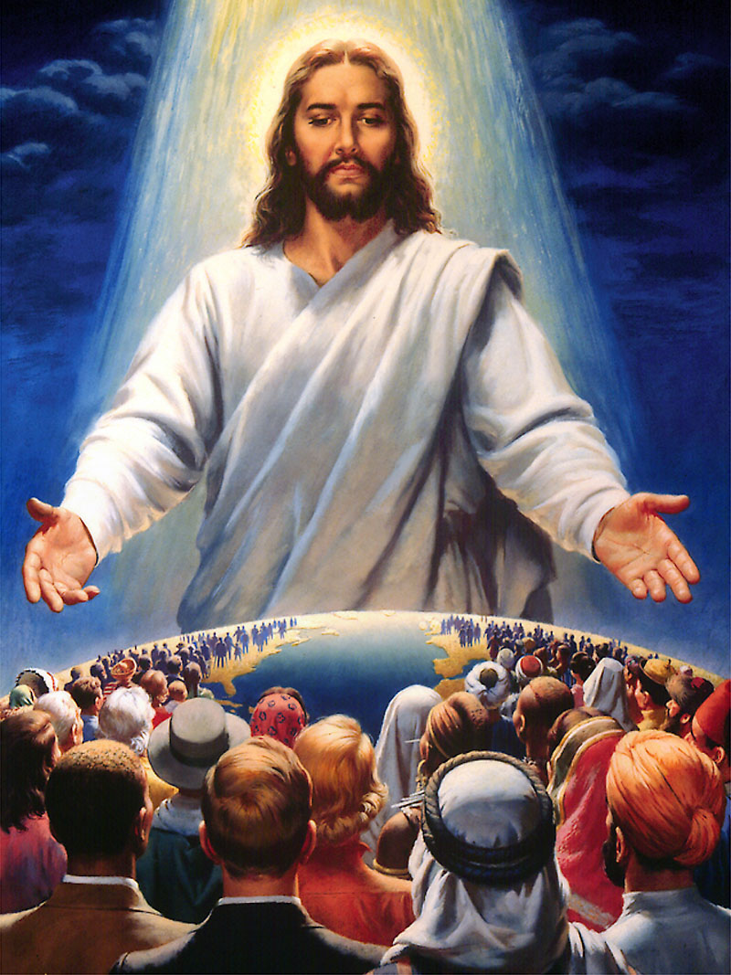
Jesus taught us to Walk in this Same Type of Faith
Mark 11
22 And Jesus answering saith unto them, Have faith in God.
23 For verily I say unto you, That whosoever shall say unto this mountain, Be thou removed, and be thou cast into the sea; and shall not doubt in his heart, but shall believe that those things which he saith shall come to pass; he shall have whatsoever he saith.
24 Therefore I say unto you, What things soever ye desire, when ye pray, believe that ye receive them, and ye shall have them.

Slide 29
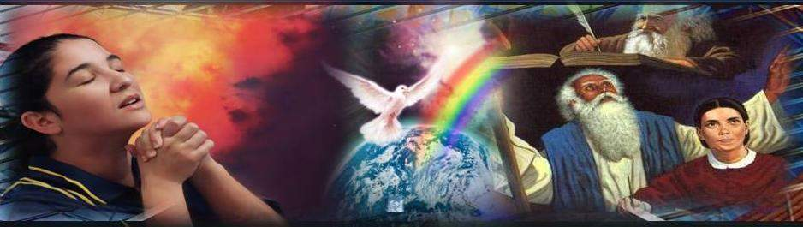
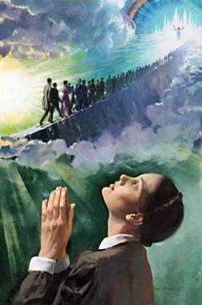
24 For this reason I am telling you, whatever you ask for in prayer, believe (trust and be confident) that it is granted to you, and you will [get it]. (Mark 11:24; Amplified Bible)

Slide 30
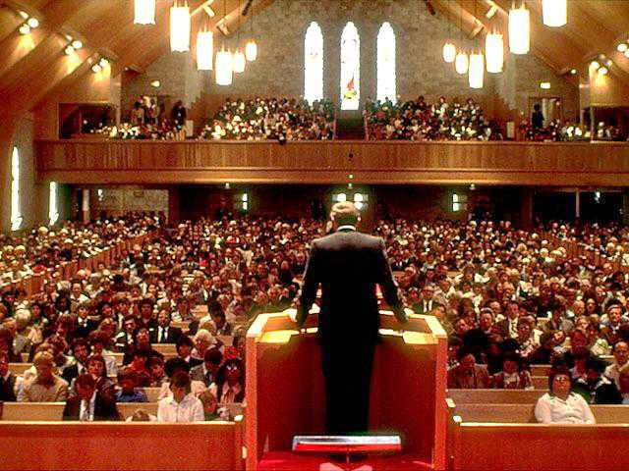
The Growth of Victorious Word Christian Fellowship

