Slide 1
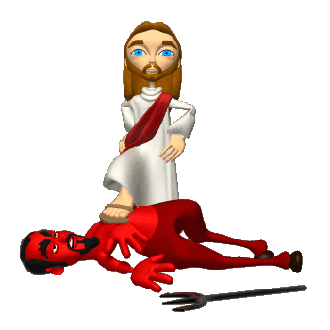
God Our
HELPER
In Our Problems

Slide 2
God is our refuge and strength, a very present help in trouble. Therefore will not we fear, though the earth be removed, and though the mountains be carried into the midst of the sea (Psalm 46:1, 2)

Slide 3
The word “troubles” in this passage comes from the Hebrew word tsarah. Strong’s dictionary gives the following definition: “tightness (that is, figuratively trouble); transitively a female rival: - adversary, adversity, affliction, anguish, distress, tribulation, trouble.”

Slide 4
1Pe 5:8 Be sober, be vigilant; because your adversary the devil, as a roaring lion, walketh about, seeking whom he may devour:
1Pe 5:9 Whom resist stedfast in the faith, knowing that the same afflictions are accomplished in your brethren that are in the world.
1Pe 5:10 But the God of all grace, who hath called us unto his eternal glory by Christ Jesus, after that ye have suffered a while, make you perfect, stablish, strengthen, settle you.

Slide 5
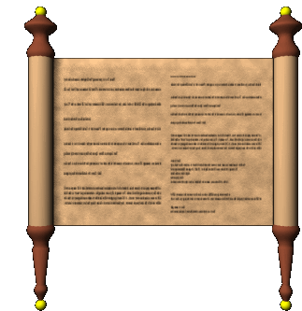
The Septuagint (the Old Testament translated into the Greek before the birth of Christ) uses the Greek word thlipsis which, according to the Strong’s dictionary means “pressure (literally or figuratively): - afflicted, (-tion), anguish, burdened, persecution, tribulation, trouble.”

Slide 6
Rev 2:9 I know thy works, and tribulation, and poverty, (but thou art rich) and I know the blasphemy of them which say they are Jews, and are not, but are the synagogue of Satan.
Rev 2:10 Fear none of those things which thou shalt suffer: behold, the devil shall cast some of you into prison, that ye may be tried; and ye shall have tribulation ten days: be thou faithful unto death, and I will give thee a crown of life.

Slide 7
Tribulation in Revelation 2:9 comes from the same Greek word - thlipsis - “pressure (literally or figuratively): - afflicted, (-tion), anguish, burdened, persecution, tribulation, trouble.”

Slide 8
God is our refuge and strength, a very present help in trouble. Therefore will not we fear, though the earth be removed, and though the mountains be carried into the midst of the sea (Psalm 46:1, 2)
Psa 91:2 I will say of the LORD, He is my refuge and my fortress: my God; in him will I trust.

Slide 9
Psa 91:14 Because he hath set his love upon me, therefore will I deliver him: I will set him on high, because he hath known my name.
Psa 91:15 He shall call upon me, and I will answer him: I will be with him in trouble; I will deliver him, and honour him.
Psa 91:16 With long life will I satisfy him, and shew him my salvation.

Slide 10

  So to the Spirit assists us in our weakness; for we do not know how to pray aright, but the Spirit pleads for us with sighs that are beyond words, and He who searches the human heart knows what is in the mind of the Spirit, since the Spirit pleads before God for the saints. We know also that those who love God, those who have been called in terms of his purpose, have his aid and interest in everything (Romans 8:26-28; The James Moffatt Translation)

